Slide 1
LoadRunner Installation Guide

Slide 2
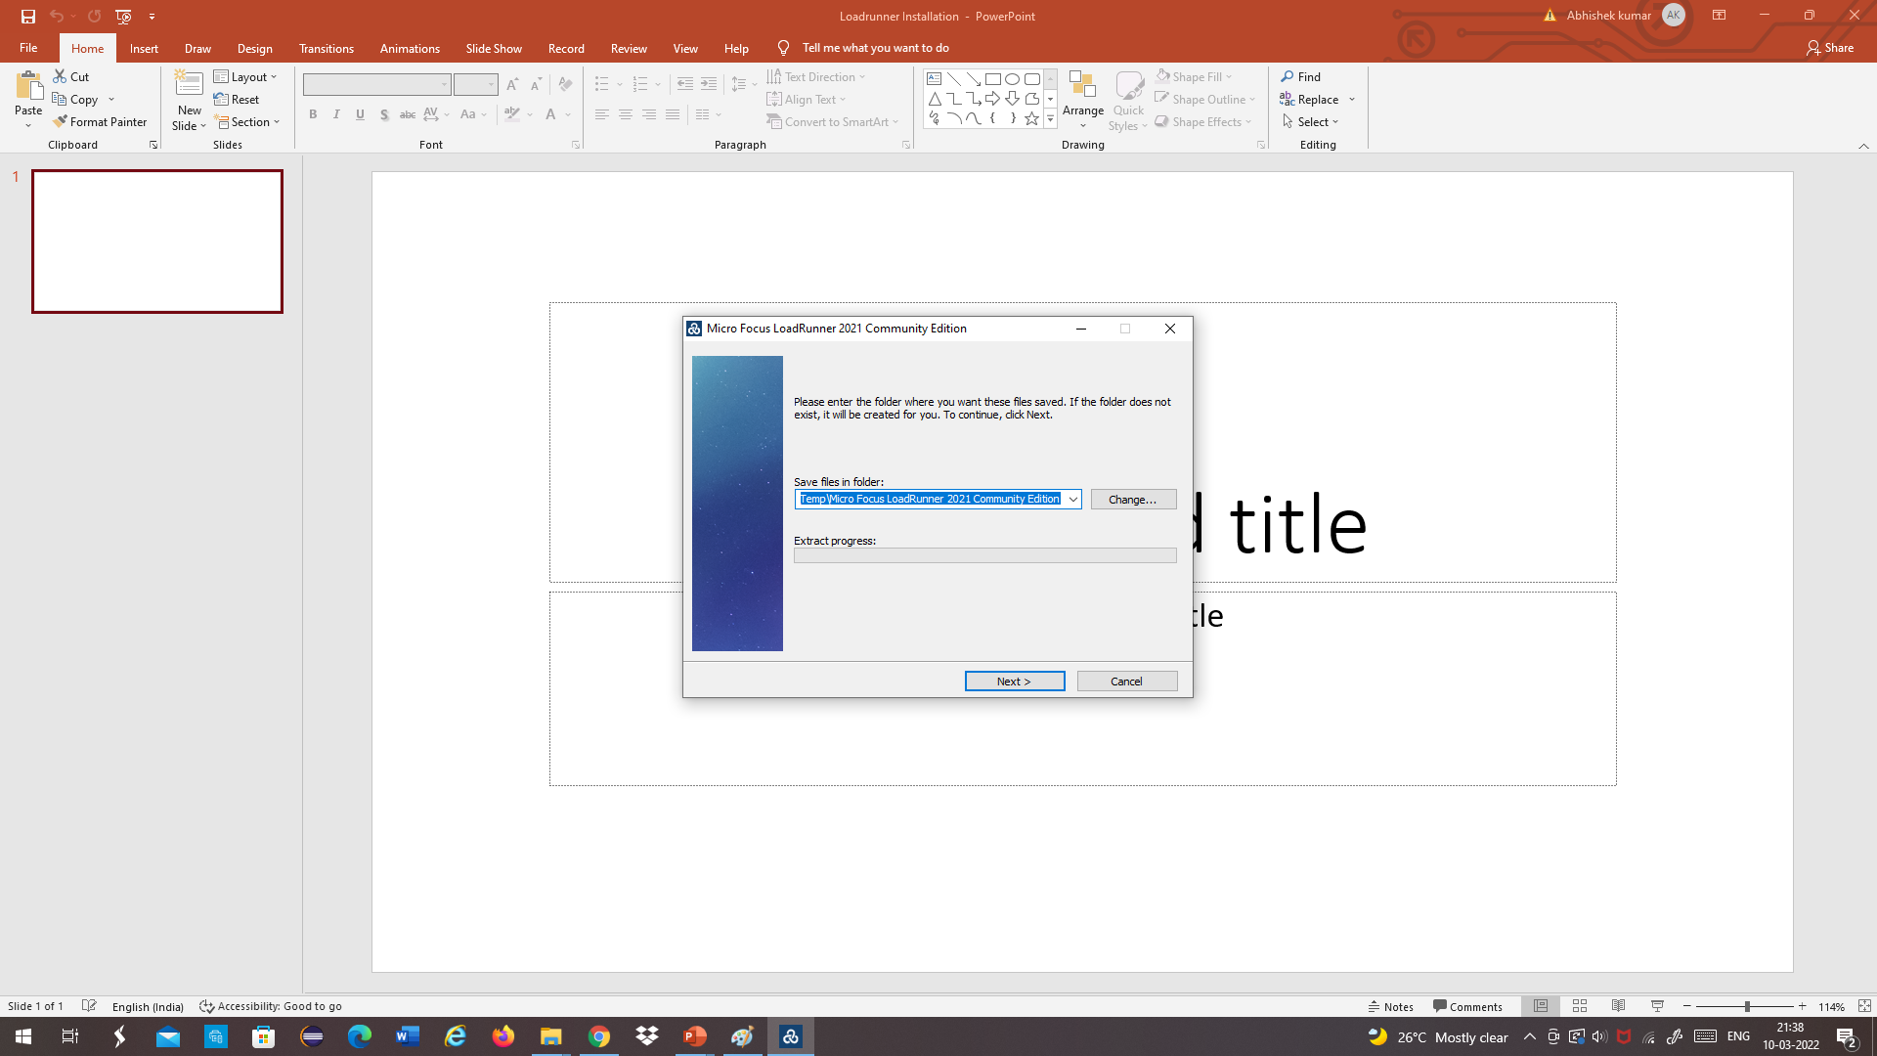
Click on LoadRunner downloaded Exe file
Click Next

Slide 3
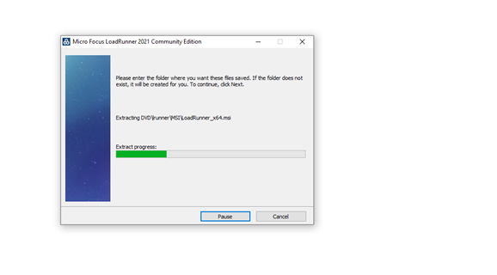
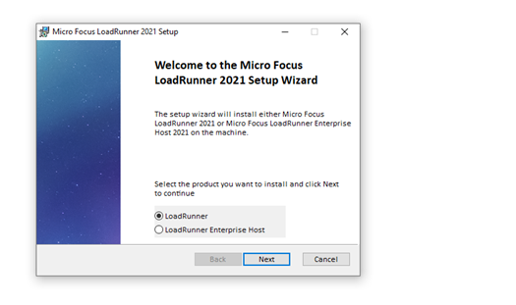
Wait for complete extraction of file
Select LoadRunner and Click Next

Slide 4
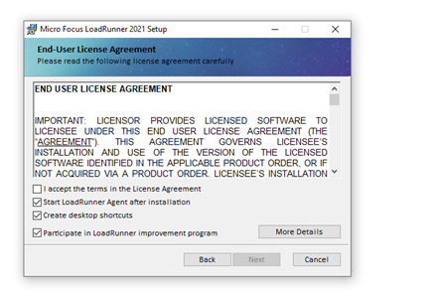
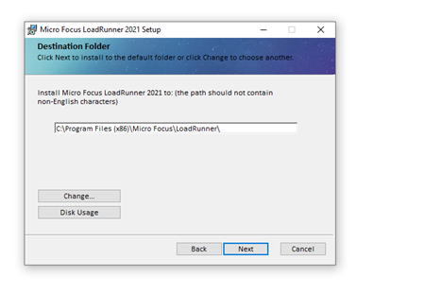
Select terms for the License agreement
Select installation location and click Next

Slide 5
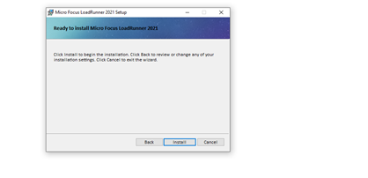
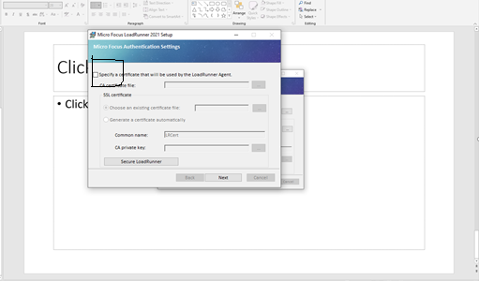
Click Install
Unselect Certificate option and click next

Slide 6
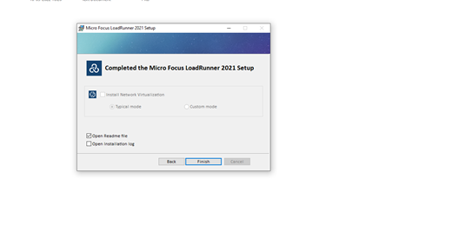
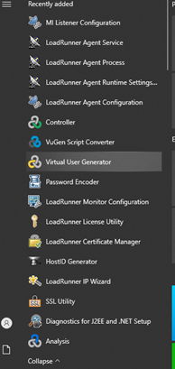
Click finish
Validate all the installation software from Windows start (Controller , Virtual User generator, Load Agent)

